Slide 1
Week 8-9

Slide 2
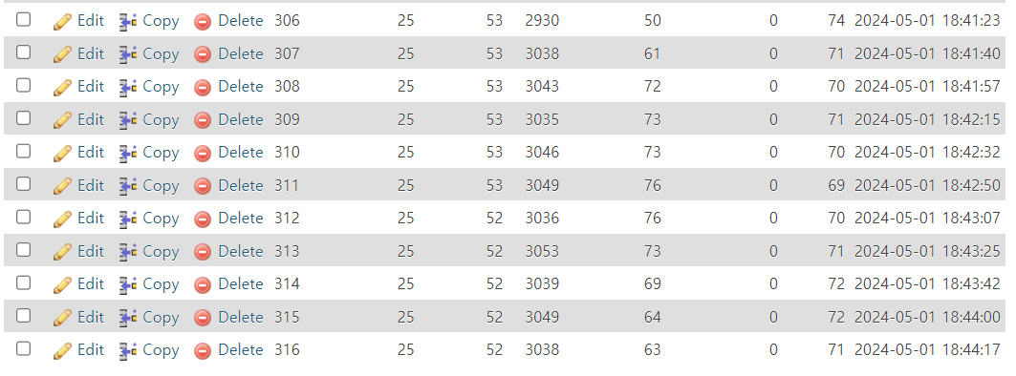
IoT Sensor
Every data(Temperature, Humidity, Light, waterLevel, SoilHumidity and steam transferred to MySQL through HTTP.

Slide 3
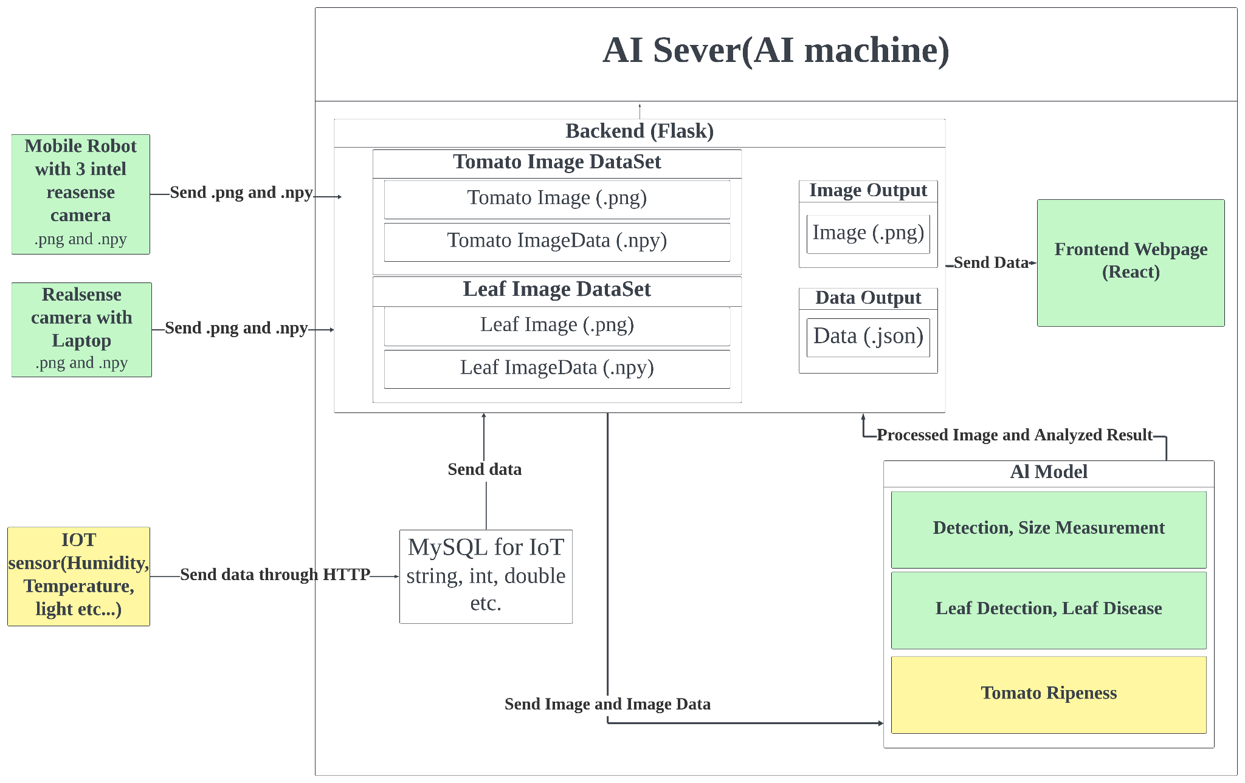
System Architecture

Slide 4
Develop/Setup the AI server
We already move the test code for showing image and iot database to the ubuntu physic server, but because the computer doesn’t have internet connection so we cannot download npm and anaconda package require to start the program.

Slide 5
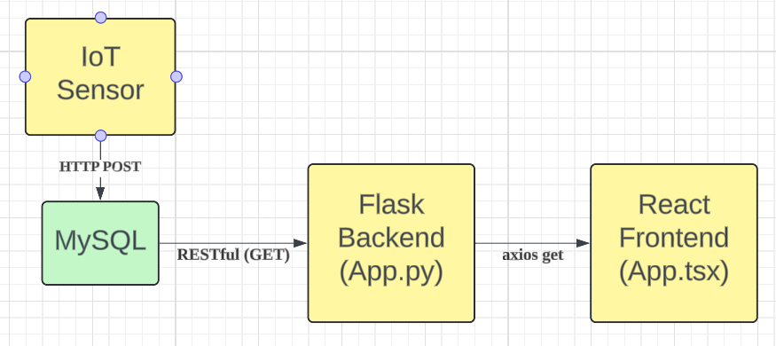
Show IoT Data captured on webpage
Fetch Data from MySQL using SQLAlchemy library.
Then use axios library to connect backend and frontend
Show MySQL data as table style.

Slide 6
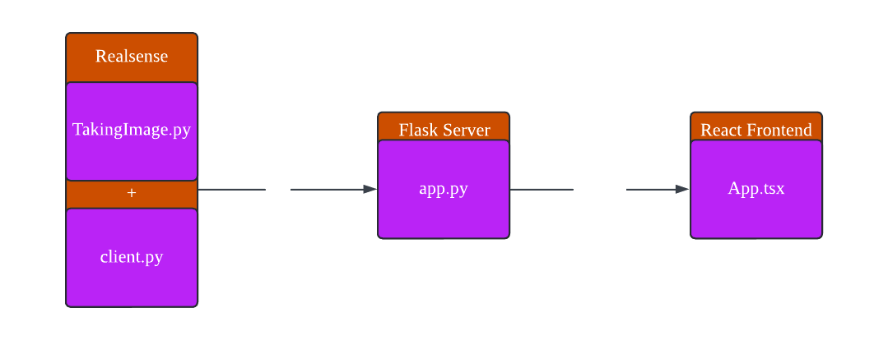
Show captured image
Capture image from laptop and goes to Image DB.
Then show this image on the webpage

